Slide 1
GDPR Practical Start
Holdingbay
where can you begin rolling out?

Slide 2

GDPR Practical Start
where can you begin rolling out?

Slide 3

Tristan Bailey
Holdingbay
  Working with marketing and sales data for over 15 years
  Develop applications
  Brighton, UK

Slide 4
What is it?
Holdingbay

Slide 5
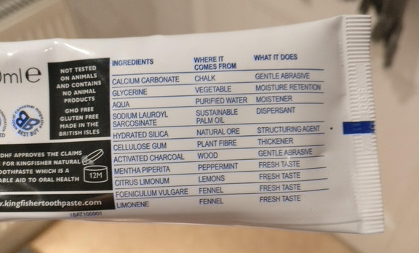
Clear what’s inside

Slide 6
Visitor Opt-In
Holdingbay
  Each form should be screen grabbed and filed
  Log the location and time of opt-in
  Use email double opt-in

Slide 7
Visitor Opt-In Controls
Holdingbay
  Clear, natural language
  Granular
  Opt-Out by default
  Group same intent

Slide 8
Cookie and Services
Holdingbay
  Audit your current cookies and 3rd party services

Slide 9
Cookie and Services
Holdingbay
  Be able to disable services based on Opt-In

Slide 10
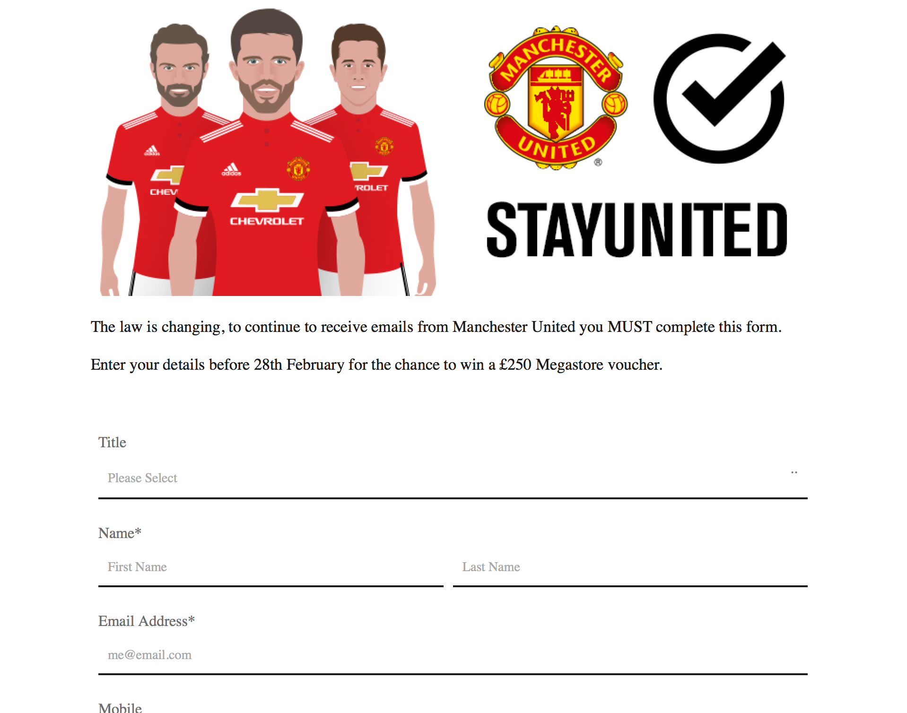

Re-engagement
Holdingbay
  For non-active email
  No record of opt-in
  Warm a subscriber action

Slide 11
Separate Personal Data
Holdingbay
  Storage should be encrypted at rest
  Data should be secure in transit
  Extract personal data to separate and control
  Consider Single Sign on system

Slide 12
Export requests
Holdingbay
  Develop a process to:
  Receive customer requests
  Process personal data to machine format (csv)
  Start with just a form and a process, add automation later.
  Can not charge for access

Slide 13
Removal requests (forgotten)
Holdingbay
  Develop a process to:
  Receive customer requests
  Remove personal data
  Unsubscribe from own automations
  Unsubscribe from 3rd party email and systems
  Keep business record, by anonymising emails
  Can not charge for the process

Slide 14
On-going process so bake in Privacy by Design
Holdingbay

Slide 15
Thank you
Holdingbay
  Any questions?
  Find more here:
  https://holdingbay.co.uk/gdpr/
  https://twitter.com/theholdingbay

